Slide 1
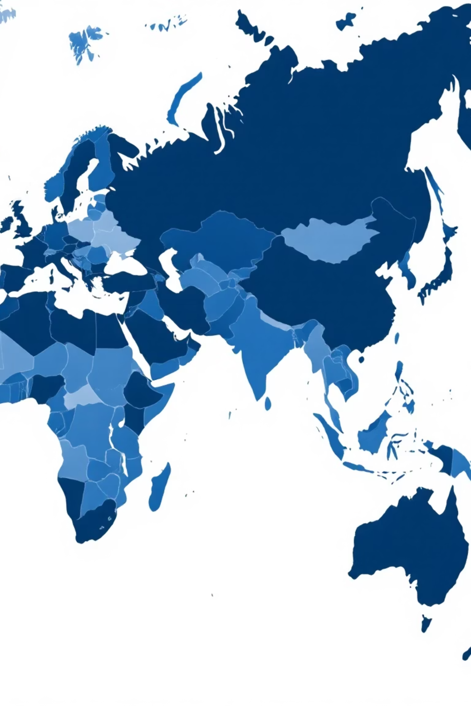
Global Income Inequality: A Visualization of Worldwide Income Metrics
Mentor Name:​
Mr. Bhargava Sai Reddy Vanga​
​
Coordinator Nam​e:​
Ms. Pranathi​

Slide 2





INTRODUCTION​
Dataset explores income inequality and wealth distribution across countries over time.
Captures key indicators: population, average income, Gini Index, top 10% and bottom 10%income shares.​
Nations are grouped into developed, developing, and low-income categories for comparison.
Analysis reveals wealth concentration, income shifts over time, and global equity implications.

Slide 3

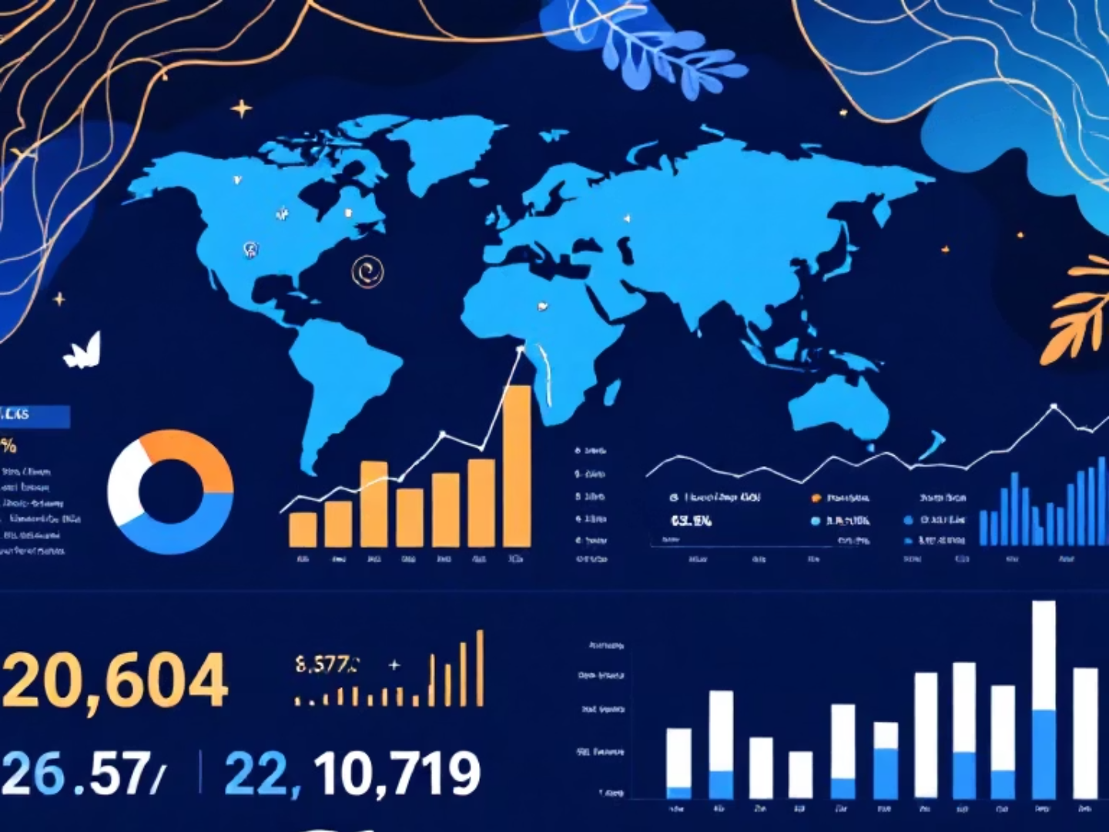


Problem Statement​
Our Data-Driven Solution Pathway
How might we personalize inequality analysis to make it more accessible and engaging for diverse types of users?
Advanced Data Visualisation
Leveraging advanced visualization to turn complex economic data into clear insights on income disparities across regions and demographics..
Comprehensive Metric Analysis
Comparing key metrics—Gini coefficient, GDP per capita, poverty rate, and income percentiles—for a holistic view of global inequality..
Actionable Intelligence
Delivering evidence-based recommendations and insights that enable stakeholders to make informed decisions for addressing inequality challenges.

Slide 4




Technology Stack: Building Robust Analytics
01
02
Data Cleaning & Preprocessing
Data Transformation
Tools: Excel, Python (Pandas, NumPy)
Tools: Power Query, Python
Standardising and cleaning raw economic data from sources, ensuring consistency and reliability across datasets.
Restructuring data into formats optimised for analysis, creating calculated fields and metrics for comprehensive inequality assessment.
03
04
Data Visualisation
Dashboard Deployment
Tools: Power BI, Tableau
Tools: Power BI Service, Tableau Online, Streamlit
Developing interactive dashboards and dynamic visualisations that make complex economic patterns accessible to diverse audiences.
Ensuring seamless access and sharing capabilities through cloud-based platforms for maximum stakeholder engagement and usability.

Slide 5
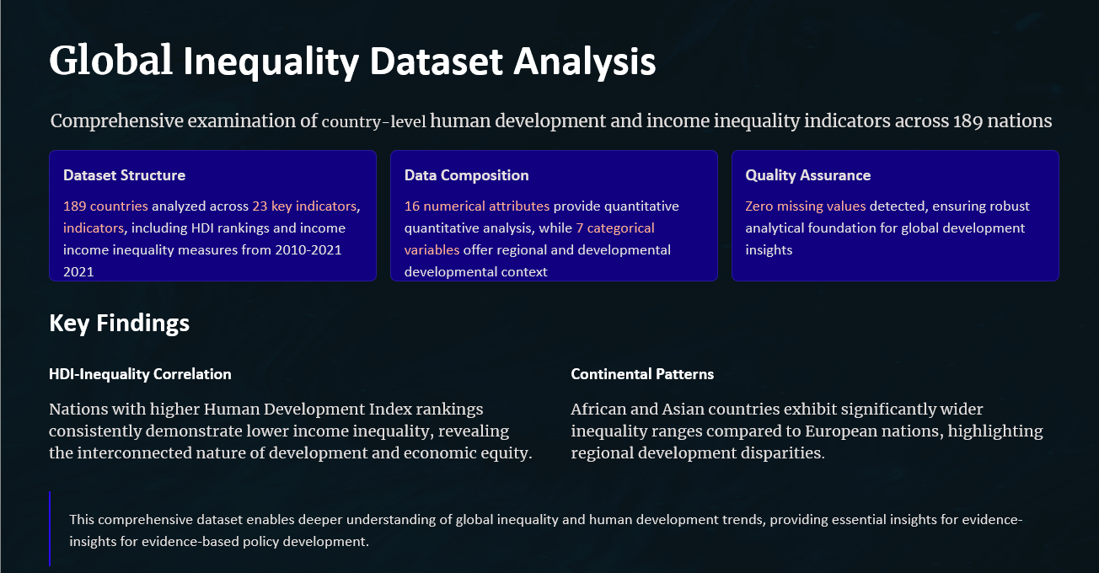

Slide 6

Challenges
Data Quality & Availability
Addressing inconsistencies in data collection methods across countries and ensuring reliable sources for comprehensive global coverage.
Missing Data Management
Developing robust strategies for handling incomplete datasets whilst maintaining integrity and avoiding bias in inequality measurements.
Complex Data Simplification
Translating economic indicators into intuitive visual formats that communicate effectively with non-technical stakeholders .

Slide 7

Future Enhancements: Expanding Our Vision
1
Real-Time Data Integration
Integrating live global data for real-time inequality insights..
2
AI-Powered Predictive Analytics
Using machine learning to forecast trends and assess policy impacts..
3
Mobile-First Accessibility
Building responsive, mobile-ready dashboards for wider access and engagement..

Slide 8

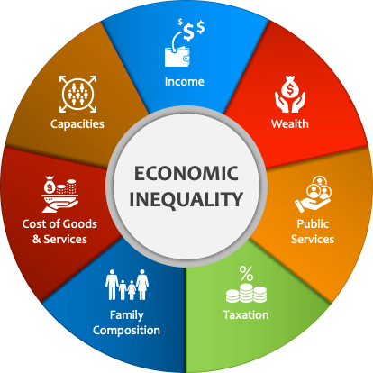
Conclusion
Critical Global Challenge
Data-Driven Solutions
Path to Equity
Advanced visualisation techniques provide tools for understanding complex patterns and informing evidence-based policy decisions.
Through innovative analytics , we can empower stakeholders to make decisions that promote more equitable economic growth.
Income inequality represents most pressing economic and social challenges of our time, requiring immediate attention and coordinated global action.

Slide 9


Thank You
Questions & Discussion : We welcome your insights and look forward to collaborating on solutions that address global income inequality

